Slide 1

Const and enum expression Default Argument in Function Inline Function User Defined Function Function Overloading
Lecture 3

Slide 2
Symbolic Constants:
There are two ways of symbolic constants in C++:
Using const
Using enum
#include <iostream>
using namespace std;
const double pi = 3.1416;
const char newline = '\n';
int main ()
{
double r=5.0;
double circle;
circle = 2 * pi * r;
cout << circle;
cout << newline;
}
C++ program using const

Slide 3

enum operator:
An enumeration provides context to describe a range of values which are represented as named constants and are also called enumerators.
#include <iostream>
using namespace std;
enum seasons { spring, summer, autumn, winter };
int main() {
cout<<"\nC++ program using enum operator\n";
cout<<spring<<endl<<summer<<endl<<autumn<<endl<<winter;
return 0;
}

Slide 4
enum
#include <iostream>
using namespace std;
enum week { Sunday, Monday, Tuesday, Wednesday, Thursday, Friday, Saturday };
int main()
{
week today;
today = Wednesday;
cout << "Day " << today+1;
return 0;
}

Slide 5
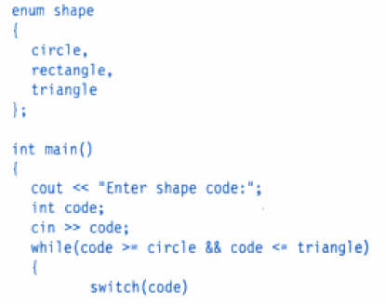
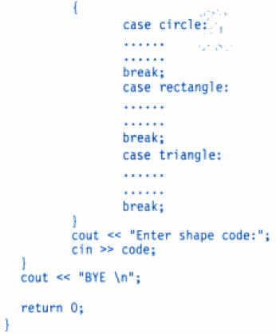
Switch using enum

Slide 6
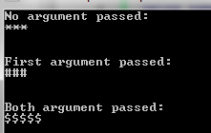
C++ Program to demonstrate working of default argument
#include <iostream>
using namespace std;
void display(char c= '*', int n= 3);
int main() {
cout<<"No argument passed:\n";
display();
cout<<"\n\nFirst argument passed:\n";
display('#');
cout<<"\n\nBoth argument passed:\n";
display('$', 5);
return 0;
}
void display(char c, int n){
for(int i = 1; i <=n; i++) {
cout<<c;
}
cout<<endl;
}

Slide 7
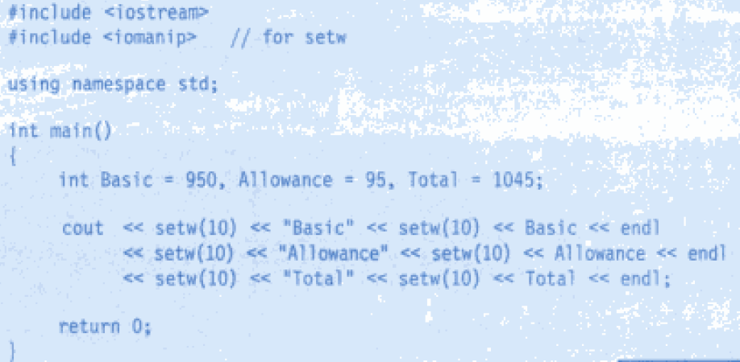
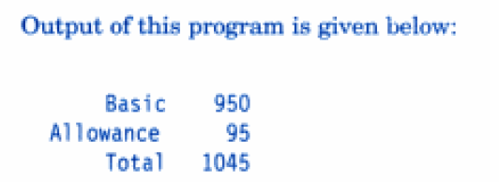
Example using iomanip:
Manipulators are operators that are used to format the data format the data display. The most commonly used manipulators are endl and setw.

Slide 8
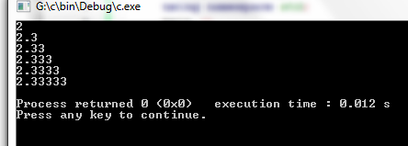
Simple example using iomanip
#include <iostream>
#include <iomanip>
using namespace std;
main ()
{
float a,b,c;
a = 7;
b = 3;
c = a/b;
cout << setprecision (1) << c << endl;
cout << setprecision (2) << c << endl;
cout <<setprecision (3) << c << endl;
cout << setprecision (4) << c << endl;
cout << setprecision (5) << c << endl;
cout << setprecision (6) << c << endl;
}

Slide 9
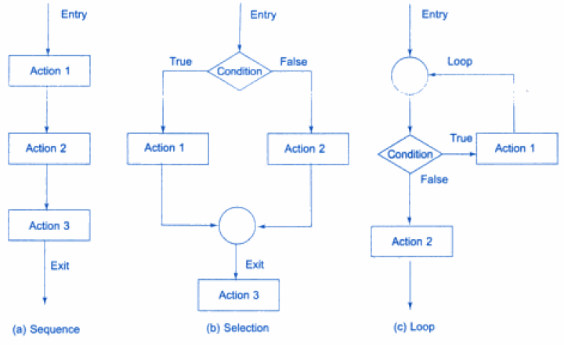

Control Structure
Three types of control structures:
Basic Control Structure

Slide 10

Inline Function
C++ inline function is powerful concept that is commonly used with classes.
If a function is inline, the compiler places a copy of the code of that function at each point where the function is called at compile time.
When inline functions are used, the overhead of function call is eliminated. Instead, the executable statements of the function are copied at the place of each function call. This is done by the compiler
A function definition in a class definition is an inline function definition, even without the use of the inline specifier.

Slide 11

Program using Inline Function
#include <iostream>
using namespace std;
inline int Max(int x, int y)
{
return (x > y)? x : y;
}
// Main function for the program
int main( )
{
cout << "Max (20,10): " << Max(20,10) << endl;
cout << "Max (0,200): " << Max(0,200) << endl;
cout << "Max (100,1010): " << Max(100,1010) << endl;
return 0;
}

Slide 12
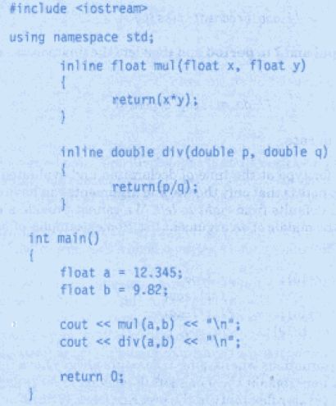
Program using Inline Function

Slide 13
User-defined Functions
User-defined functions in C++
Value-returning functions - functions that have a data type.
Void functions - functions that do not have a data type.

Slide 14
Void functions
#include<iostream>
using namespace std;
void MyPrint()
{
cout << "Printing from a function.\n";
}
int main()
{
MyPrint();
return 0;
}

Slide 15
Value-returning functions
#include<iostream>
using namespace std;
int Add(int output1, int output2)
{
return output1 + output2;
}
int main()
{
int answer, input1, input2;
cout << "Give a integer number:";
cin >> input1;
cout << "Give another integer number:";
cin >> input2;
answer = Add(input1,input2);
cout << input1 << " + " << input2 << " = " << answer;
return 0;
}

Slide 16
Function to return the larger of two numbers.
double larger(double x, double y)
{
double max;
if(x >= y)
max = x;
else
max = y;
return max;
}

Slide 17

Write a program using function which accept two integers as an argument and return its sum.
# include <iostream>
using namespace std;
int sum(int, int);
int main()
{ int x,y,s;
cout<<"Enter first number : ";
cin>>x;
cout<<"Enter second number : ";
cin>>y;
s=sum(x,y);
cout<<"The sum is : "<<s;
return 0;
}
int sum(int a, int b)
{ int total;
total=a+b;
return total;
}

Slide 18
Write a function to calculate the factorial value of any integer as an argument.
#include<iostream>
using namespace std;
int factorial(int);
int main(){
int x,f;
cout<<"Enter number : ";
cin>>x;
f=factorial(x);
cout<<"The factorial is :"<<f;
return 0;}
int factorial(int a){
int fact=1;
while(a>=1)
{
fact=fact*a;
a--;
}
return fact;
}

Slide 19
Categories of User Defined Function
For better understanding of arguments and return in functions, user-defined functions can be categorized as:
Function with no argument and no return value.
Function with no argument but return value.
Function with argument but no return value.
Function with argument and return value.

Slide 20

Function Overloading:
#include <iostream>
using namespace std;
void test(int);
void test(float);
void test(int, float);
int main() {
int a = 10;
float b = 50.5;
test(a);
test(b);
test(a, b);
return 0;
}
void test(int var)
{
cout<<"Integer number: "<<var<<endl;
}
void test(float var)
{
cout<<"Float number: "<<var<<endl;
}
void test(int var1, float var2)
{
cout<<"Integer number: "<<var1;
cout<<" And float number:"<<var2<<endl;
}

Slide 21
Function Overloading:
In C++ programming, two functions can have same identifier(name) if either number of arguments or type of arguments passed to functions are different.
These types of functions having similar name are called overloaded functions.
Two or more overloaded functions can have the same name
However, either the argument types or the number of the arguments or both of the overloaded functions must different.
Return type of the overloaded functions might be the same or different
Return type alone is not a sufficient difference to allow function overloading
Reduces the complexity of a program by allowing related operations to be referred to by the same name
/* Example of function overloading */
int test() { }
int test(int a){ }
int test(double a){ }
int test(int a, double b){ }

Slide 22
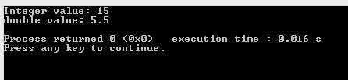
#include <iostream>
using namespace std;
void Sum(int a, int b);
void Sum(double a, int b);
int main()
{
Sum(10, 5);
Sum(10.5, 5);
return 0;
}
void Sum(int a, int b)
{
cout<< "Integer value: " << a+b <<endl ;
}
void Sum(double a, int b)
{
cout<< "double value: " << a+b <<endl ;
}

Slide 23
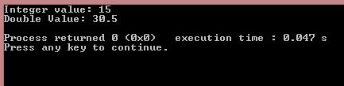
#include <iostream>
using namespace std;
class FunctionOverloading
{
public:
void Sum(int a, int b);
void Sum(double a, int b);
};
void FunctionOverloading::Sum(double a, int b)
{
cout<<"Double Value: " <<a+b<<endl;
}
void FunctionOverloading::Sum(int a, int b)
{
cout<< "Integer value: " << a-b<<endl ;
}
int main()
{
FunctionOverloading ob;
ob.Sum(25,10);
ob.Sum(25.5,5);
return 0;
}

